Slide 1






Data Wrangling
ASG 2
Tan Jun Yu Zavier
(S10255651D)

Slide 2



Table of contents
01
Introduction
02
Data Exploration
03
Machine Learning Models
04
Conclusion

Slide 3



01
Introduction

Slide 4





01-Introduction
1871 - 2014
AIM
Role
Outcome
Datasets
How might we
Predict MLB players’ salaries using performance metrics
Data Analyst
Provide valuable insights to potential management team, optimising allocation of financial resources and making strategic decisions.
Datasets used are
salary
player
fielding
pitching
batting

Slide 5


01-Target Variable

Slide 6


02
Data Exploration

Slide 7
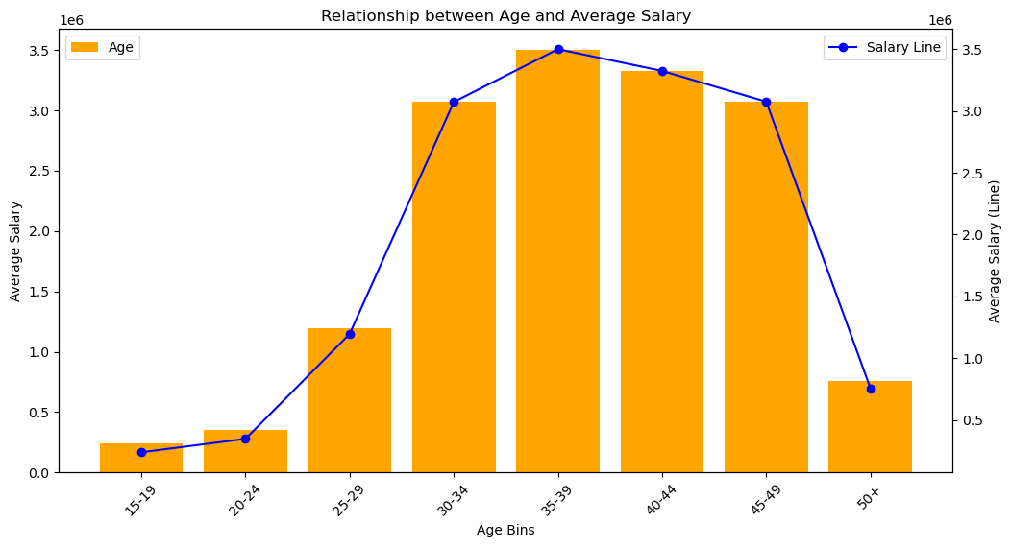
Salary & Age Relationship
Early Career Growth
Peak Earning Age
Decline After Prime
Notes:
Early Career Growth: The salary growth trend shows a steady increase from the early age brackets (15-24), indicating that younger players see a gradual rise in earnings as they gain more experience and possibly performance metrics.
Peak Earning Age: The graph shows that players' salaries tend to peak in the 30-34 and 35-39 age ranges, indicating that players in these age groups are likely at the height of their earning potential.
Decline After Prime: There is a noticeable decline in average salaries starting from the 40-44 age range, with a significant drop by the 50+ age group, suggesting that as players age beyond their prime years, their market value decreases.

Slide 8
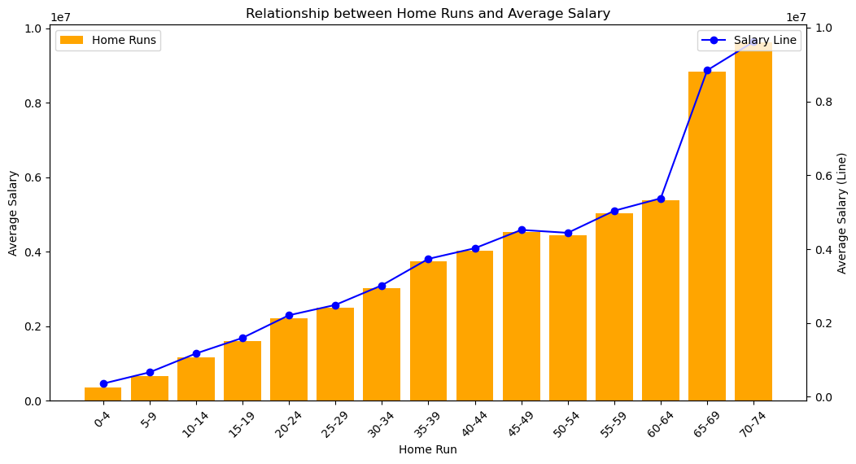
Salary & Home Run Relationship
Higher Home Runs, Higher Salary
Significant Salary Jumps at Higher Home Runs
Performance Incentive
Notes:
Higher Home Runs, Higher Salary: The visual clearly shows that as the number of home runs increases, the average salary of players also tends to increase. This trend is particularly noticeable after players hit 30 or more home runs.
Significant Salary Jumps at Higher Home Runs: There are sharp increases in average salary for players hitting 45-49 home runs and 65-69 home runs, indicating that reaching these higher performance thresholds can significantly impact earnings.
Performance Incentive: The positive correlation between home runs and salary suggests that teams may place a high value on players who demonstrate strong power-hitting capabilities, rewarding them with higher salaries. This insight can be useful for players and agents negotiating contracts based on performance metrics.

Slide 9
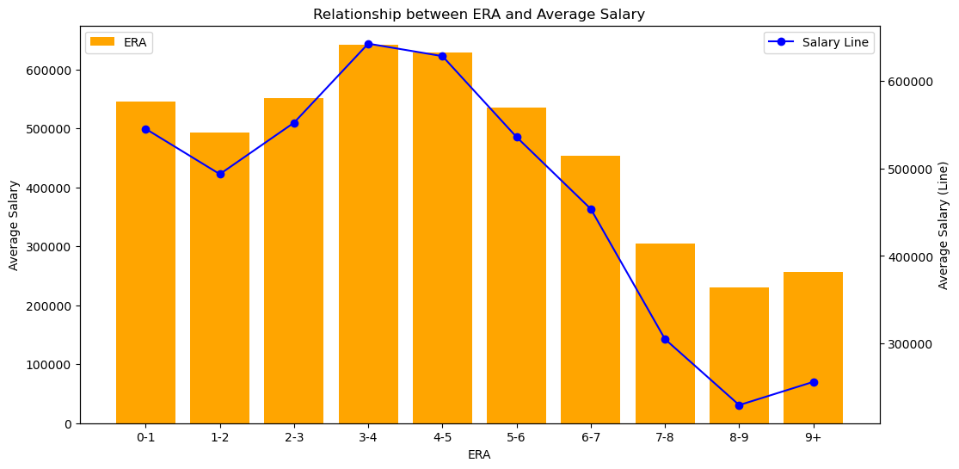
Salary & Earned Run Average Relationship
Lower ERA, Higher Salary
Mid-Range Peaks
Decline at Higher ERA
Notes:
Lower ERA, Higher Salary: Players with a lower ERA generally have higher average salaries, indicating a preference for effective pitching.
Mid-Range Peaks: Significant peaks in salary are observed in players with an ERA between 3 and 4.
Decline at Higher ERA: There is a noticeable decline in average salary as the ERA increases beyond 4, suggesting less valuation for higher ERA pitchers.

Slide 10
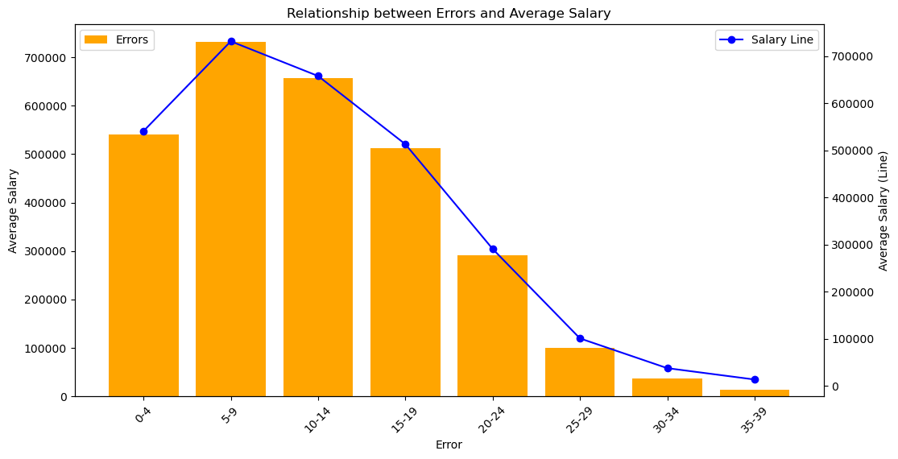
Salary & Errors Relationship
Negative Correlation Between Errors and Salary
Significant Salary Drop with Increased Errors
Peak Salary for Moderate Error Ranges
Notes:
Negative Correlation Between Errors and Salary: The graph shows a general downward trend in average salary as the number of errors increases. This suggests that players with fewer errors tend to earn higher salaries, indicating that defensive reliability is highly valued in determining player compensation.
Significant Salary Drop with Increased Errors: There is a noticeable drop in average salary beyond 15-19 errors, which becomes more pronounced as the error count increases. This drop signifies that players who commit more errors may face a significant penalty in their earnings, reflecting the importance of defensive consistency in salary negotiations.
Peak Salary for Moderate Error Ranges: Interestingly, players with 5-9 errors appear to have a peak in average salary, possibly indicating that a small number of errors might be tolerated, especially if these players contribute significantly in other areas. This highlights the complex evaluation process teams might use, balancing offensive and defensive metrics in salary decisions.

Slide 11
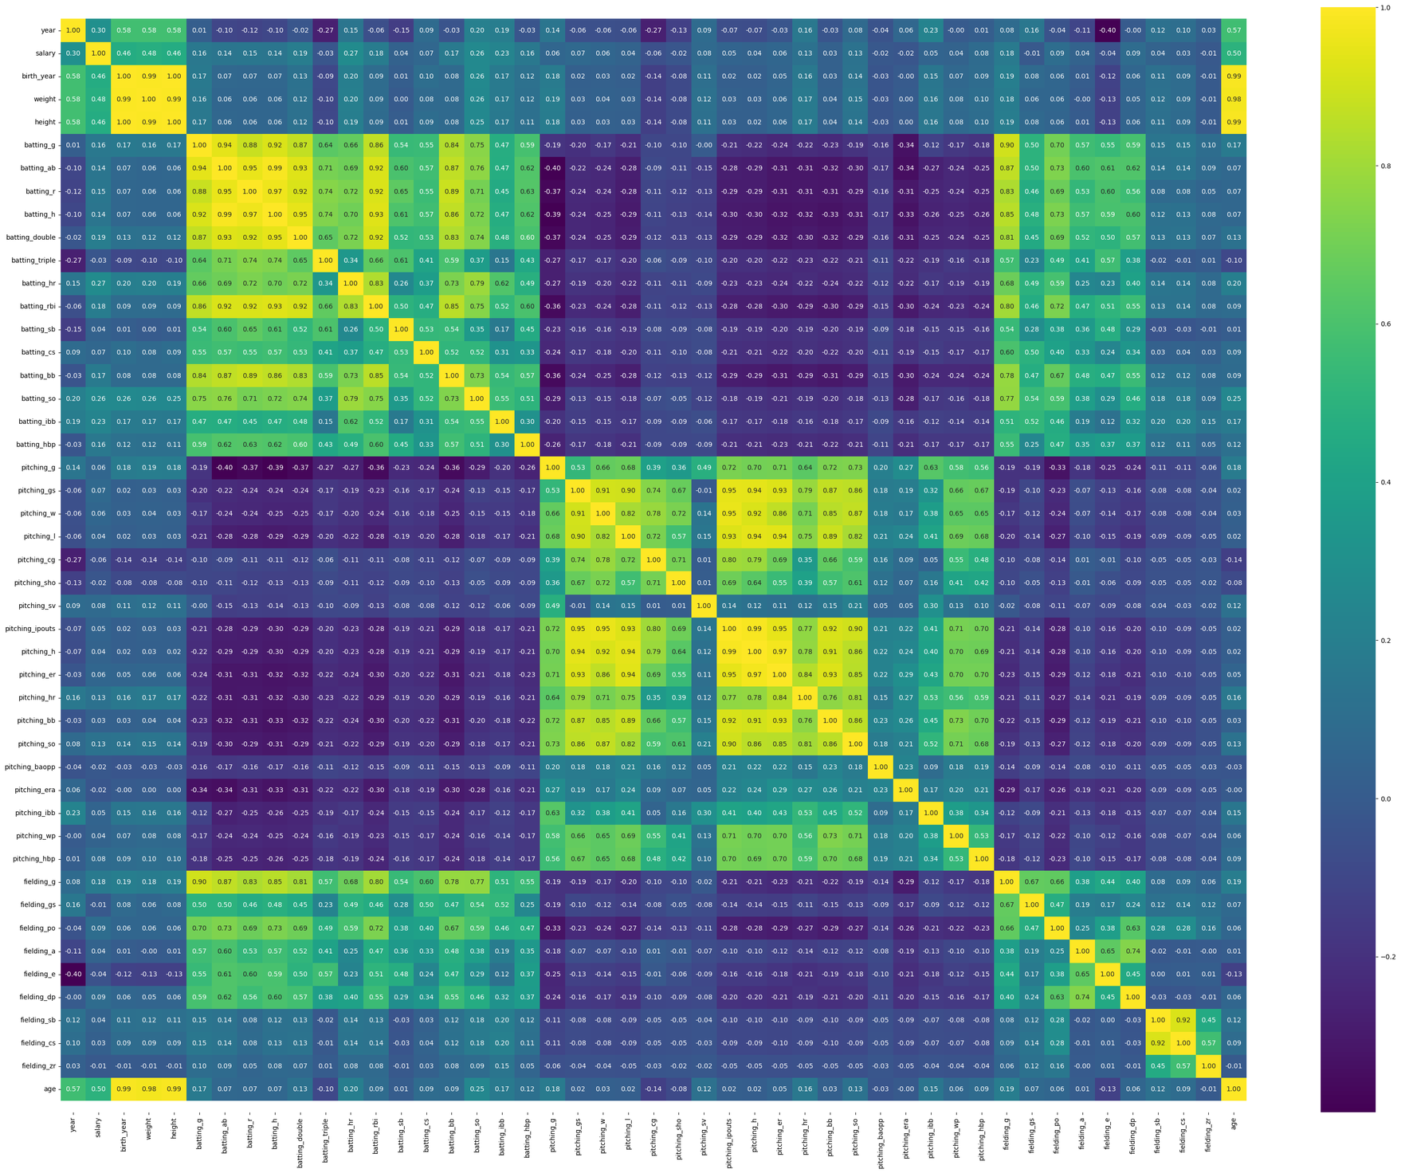

Correlation Matrix

Slide 12

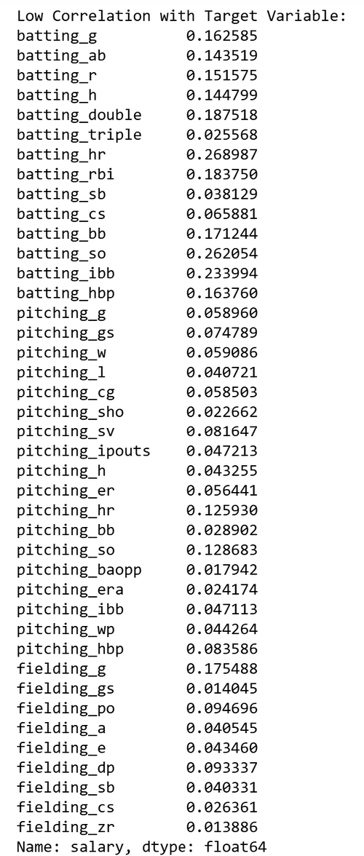
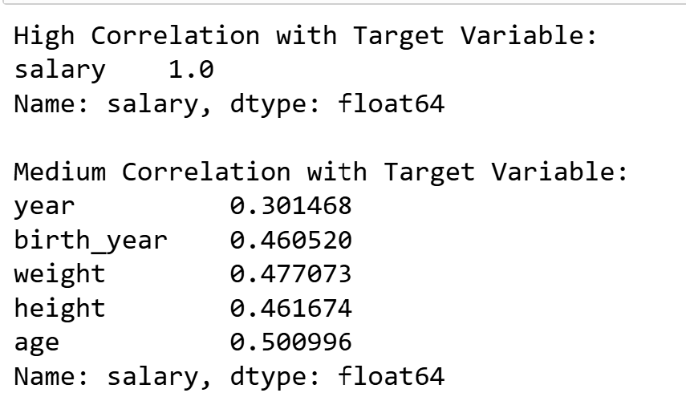

Correlation Matrix
Target Variable
“Salary”

Slide 13

03
Machine Learning Models

Slide 14

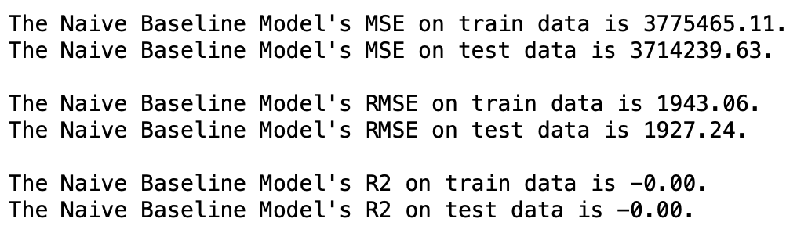
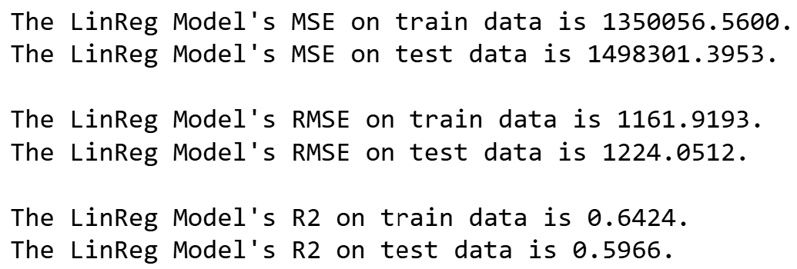


03-Machine Learning Models
Naive Baseline Model
MSE Change
Train Data: MSE decreased by approximately 64.23%
Test Data: MSE decreased by approximately 59.64%
What does this mean?
Better performance and prediction accuracy.
Linear Regression Model

Slide 15

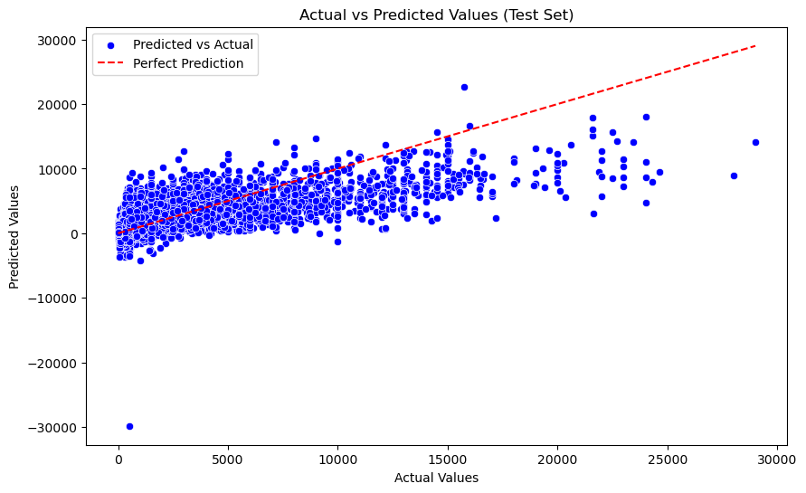
03-Model Performance
The Linear Regression Model has an R² value of approximately 0.6424 on train data and 0.5966 on test data, showing that it explains around 60% of the variability in salaries.
Blue Dots (Predicted vs. Actual)
Each blue dot represents a player, showing the relationship between their actual salary and the salary predicted by the model.
Red Dashed Line (Perfect Prediction)
The red dashed line represents a perfect prediction scenario where the predicted salaries would match the actual salaries exactly. The closer the blue dots are to this line, the more accurate the model's predictions are.

Slide 16

04
Conclusion

Slide 17


04-Conclusion
Data Insights Gathered
Players with higher counts in key performance metrics such as Home Runs, Runs Batted In (RBIs), and Wins generally command higher salaries. This trend highlights the value teams place on strong offensive and pitching performance.
Player salaries tend to peak in the age range of 30-39. Younger players (under 25) and older players (over 40) generally earn less, possibly due to perceived potential and physical decline, respectively.
Players with better fielding metrics, such as fewer Errors and more Assists and Putouts, tend to earn higher salaries. This suggests that defensive skills are an important factor in salary determination.

Slide 18
04-Conclusion
Recommendations
Consider structuring contracts that heavily incentivize performance metrics such as Home Runs, RBIs, and Wins. This approach not only rewards top-performing players but also aligns their incentives with team success.
Recruitment and scouting efforts should prioritize players in the 30-39 age range, where performance and experience peak. However, teams should also strategically invest in younger players to ensure a pipeline of talent for the future.
Given the importance of fielding performance metrics like Assists and Putouts, teams should enhance defensive training programs. This can help improve players' defensive skills, making them more valuable and potentially increasing their salaries.

Slide 19
Thanks!
CREDITS: This presentation template was created by Slidesgo, and includes icons by Flaticon, and infographics & images by Freepik

